Slide 1

AIV
Autonomous Irrigation Vehicle
Group 4
Joshua Betetta (EE)
Parameswari Chandrasekar (CpE)
Stuart Munich (CpE)
Roberto Santos (EE)
Sponsor by Guard Dog Valves

Slide 2


AIV Motivation
According to the EPA "Depending on the region, homeowners use between 30 and 70 percent of their water outdoors." and Experts estimate that "50 percent of the water we use outdoors goes to waste from evaporation, wind, or runoff due to overwatering."
According to the University of Florida "If you water too much, the roots don't have any incentive to grow deep, so you end up with a lawn that's weak, susceptible to pests, disease and has shallow roots"
We are already exceeding the capacity of the Floridan Aquifer System to supply adequate water to maintain springs health. The only way to restore health to these springs is to greatly reduce our reliance on groundwater from the Floridan Aquifer System.

Slide 3
Existing Issues with Current Watering System and Objectives
Current Issues
Project Objectives
Expensive
Invasive
Frequent Maintenance
User Error
Effective watering
Monitoring soil
User friendly
Autonomous movement & obstacle avoidance
Cost saving
Durable

Slide 4

The Benefits
Cost savings
Modern Sprinkler Head: $50+ annual savings
Moisture Sensors: $35+annual savings
Average Yard: $415+ annual savings
Increased Accuracy of Watering: $15 annual savings
Energy cost of existing small pump: $30 annual
More effective watering
Low maintenance
Overall healthier yard
Availability for bulk application to communities
All cost savings would multiply by multiple yards covered

Slide 5

Specifications
Component | Design Specification
Vehicle Size | 21.10” x 24.13” x 5.55” (L x W x H)
Obstacle Detection Distance | 2 cm to 6 m
Time to Water Designated Area | ≤1 hour per zone
Targeted Rate of Water Flow | 24 Gallons Per Minute
Average Lawn Size | .25 acre (10890 ft^2)
Battery Life | ≤1 hour
Printed Circuit Board Size | 6” x 5” (L x W)

Slide 6
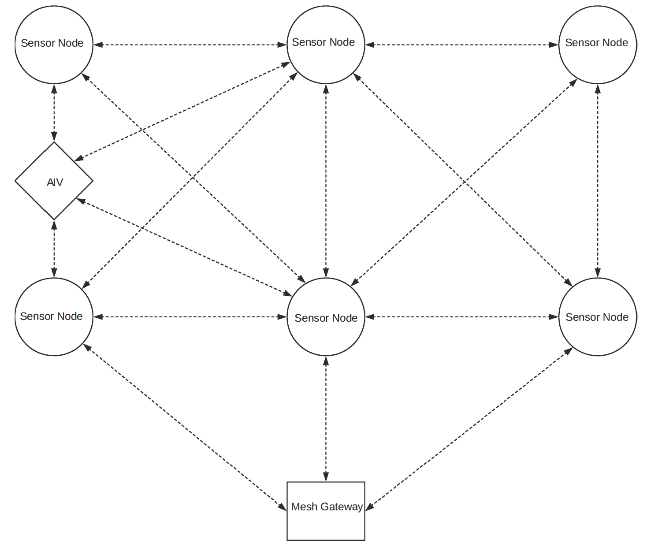
Overall System Diagram

Slide 7
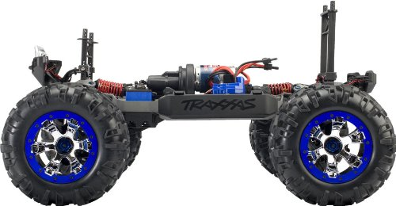
Drive System: Traxxas Summit 1/10th Scale
4 wheel drive
Durable suspension
Modular for modification of all parts
Proper scale for designed prototype
Relatively low weight
Comes with reliable, rechargeable battery

Slide 8
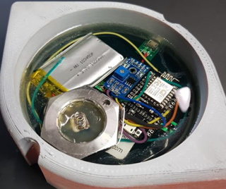

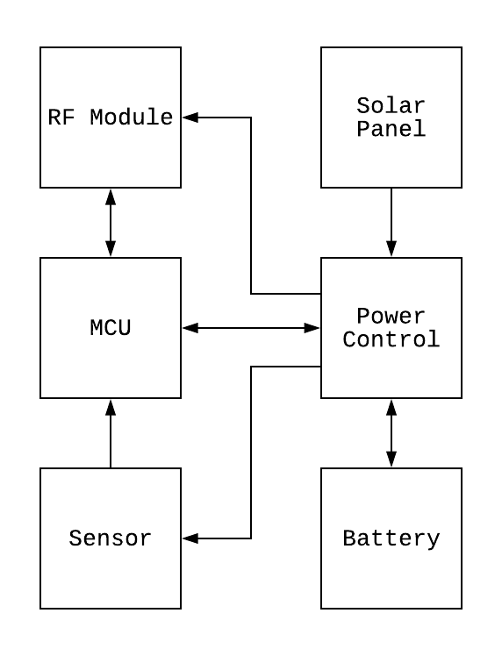
Wireless Node
Improvement on Triton
Moisture, humidity and temperature
Durable enclosure

Slide 9
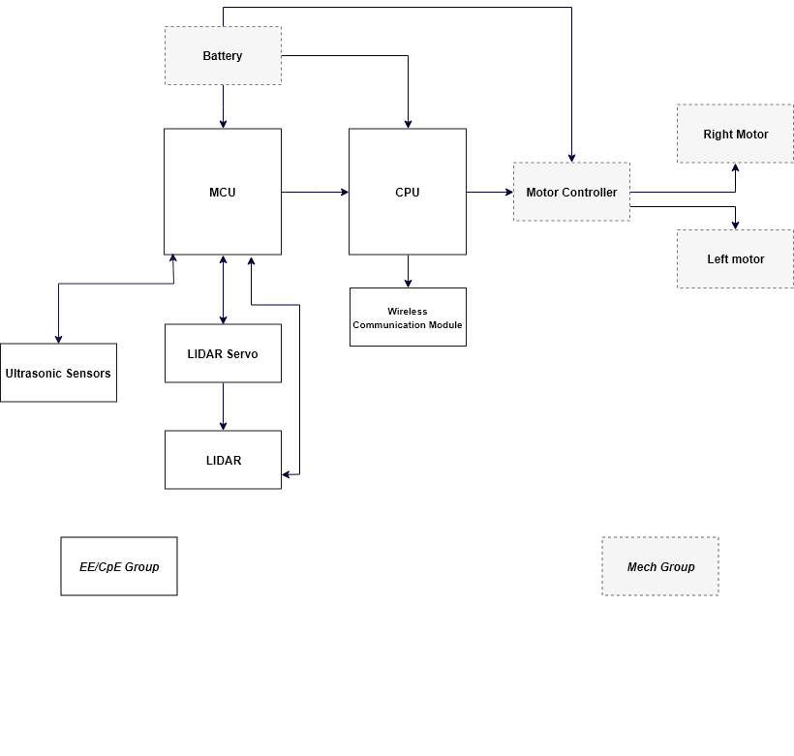
Hardware Block Diagram

Slide 10
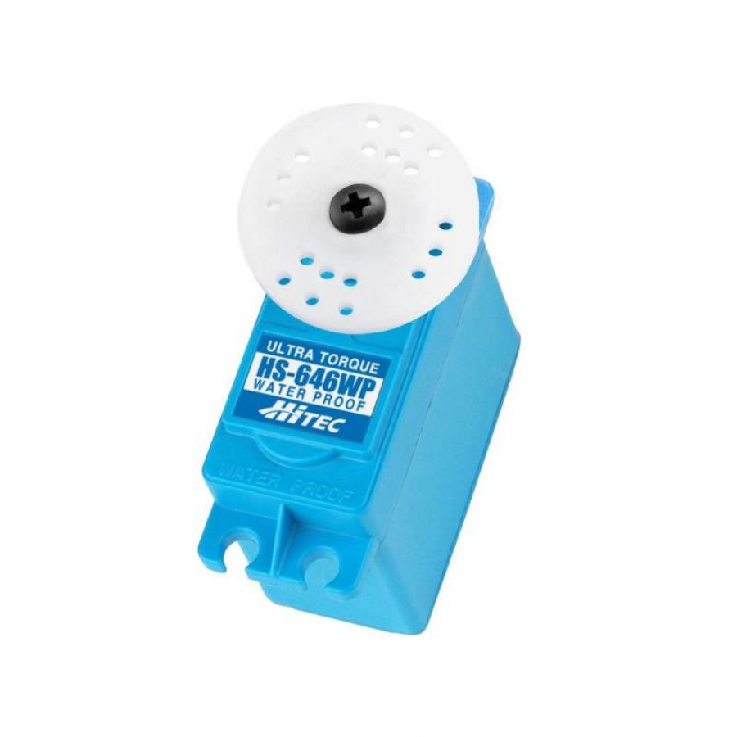
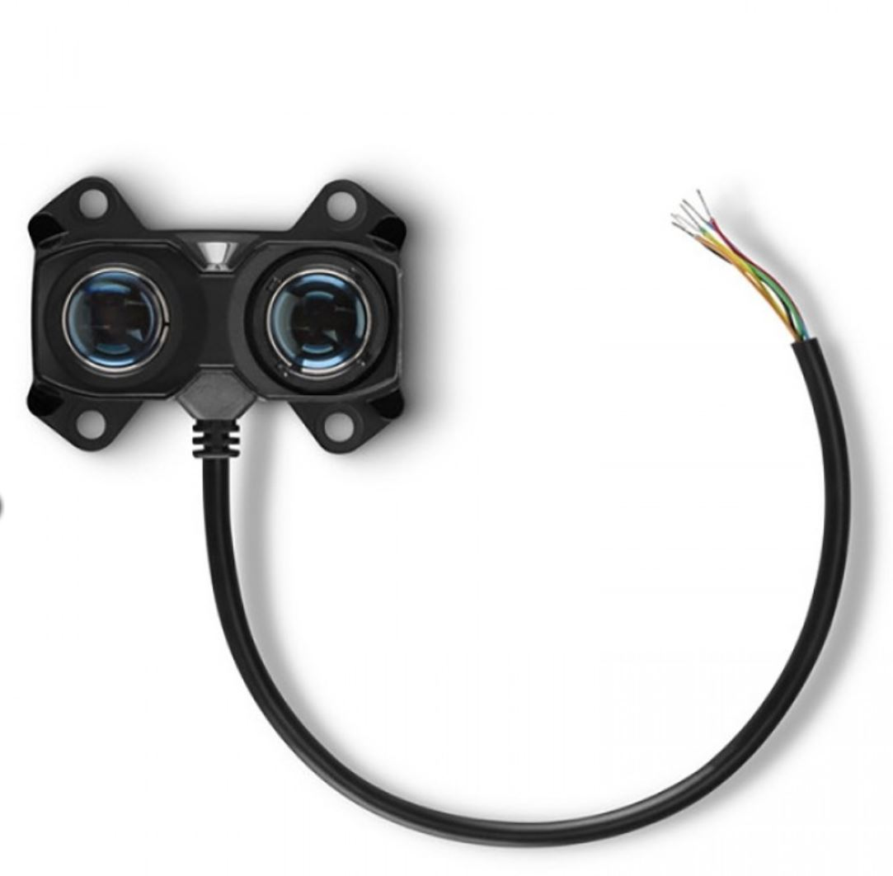
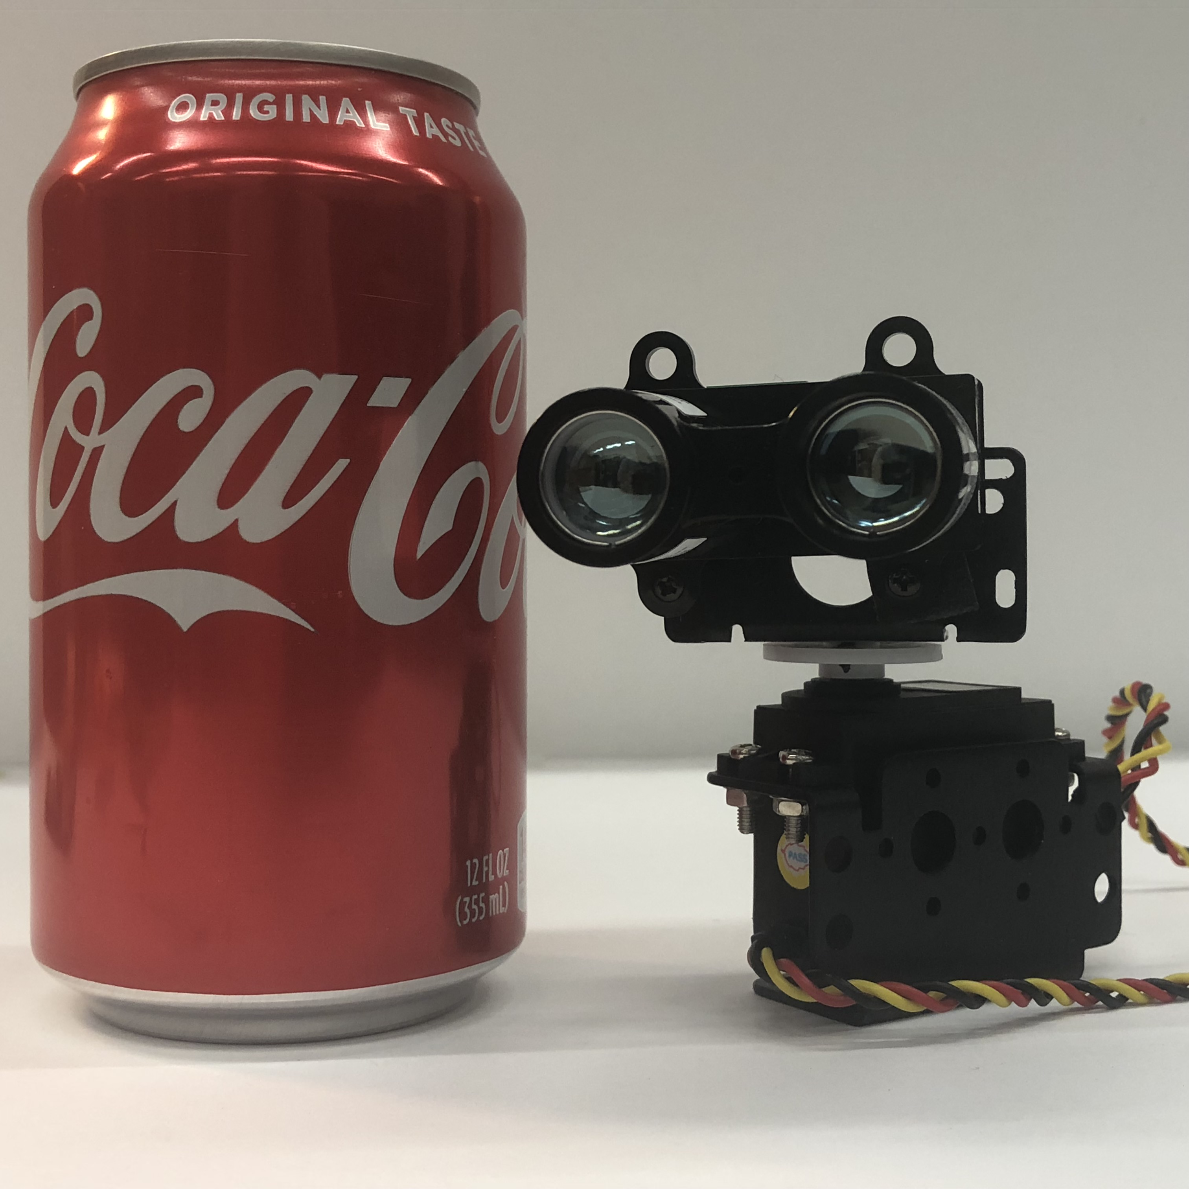

LIDAR
Purpose
Setup
Weatherproofing
LIDAR
Servo
Manufacturer | Garmin
Accuracy | +/- 2.5 cm
Range | 0-40 Meters
Power | 4.75-5 VDC
Interface | I2C

Slide 11
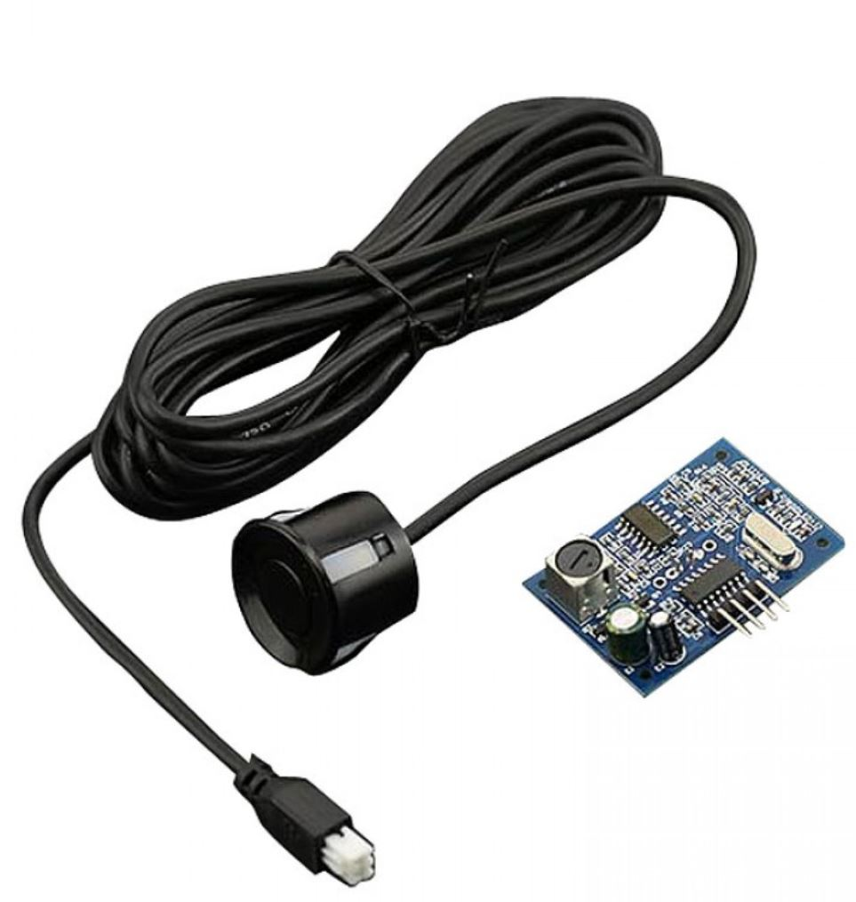
Ultrasonic Range Finder
Purpose
Weatherproofing
Manufacturer | DFRobot
Resolution | 0.5 cm
Range | 25 cm to 450 cm
Detecting Angle | < 70°
Power | 5 VDC

Slide 12
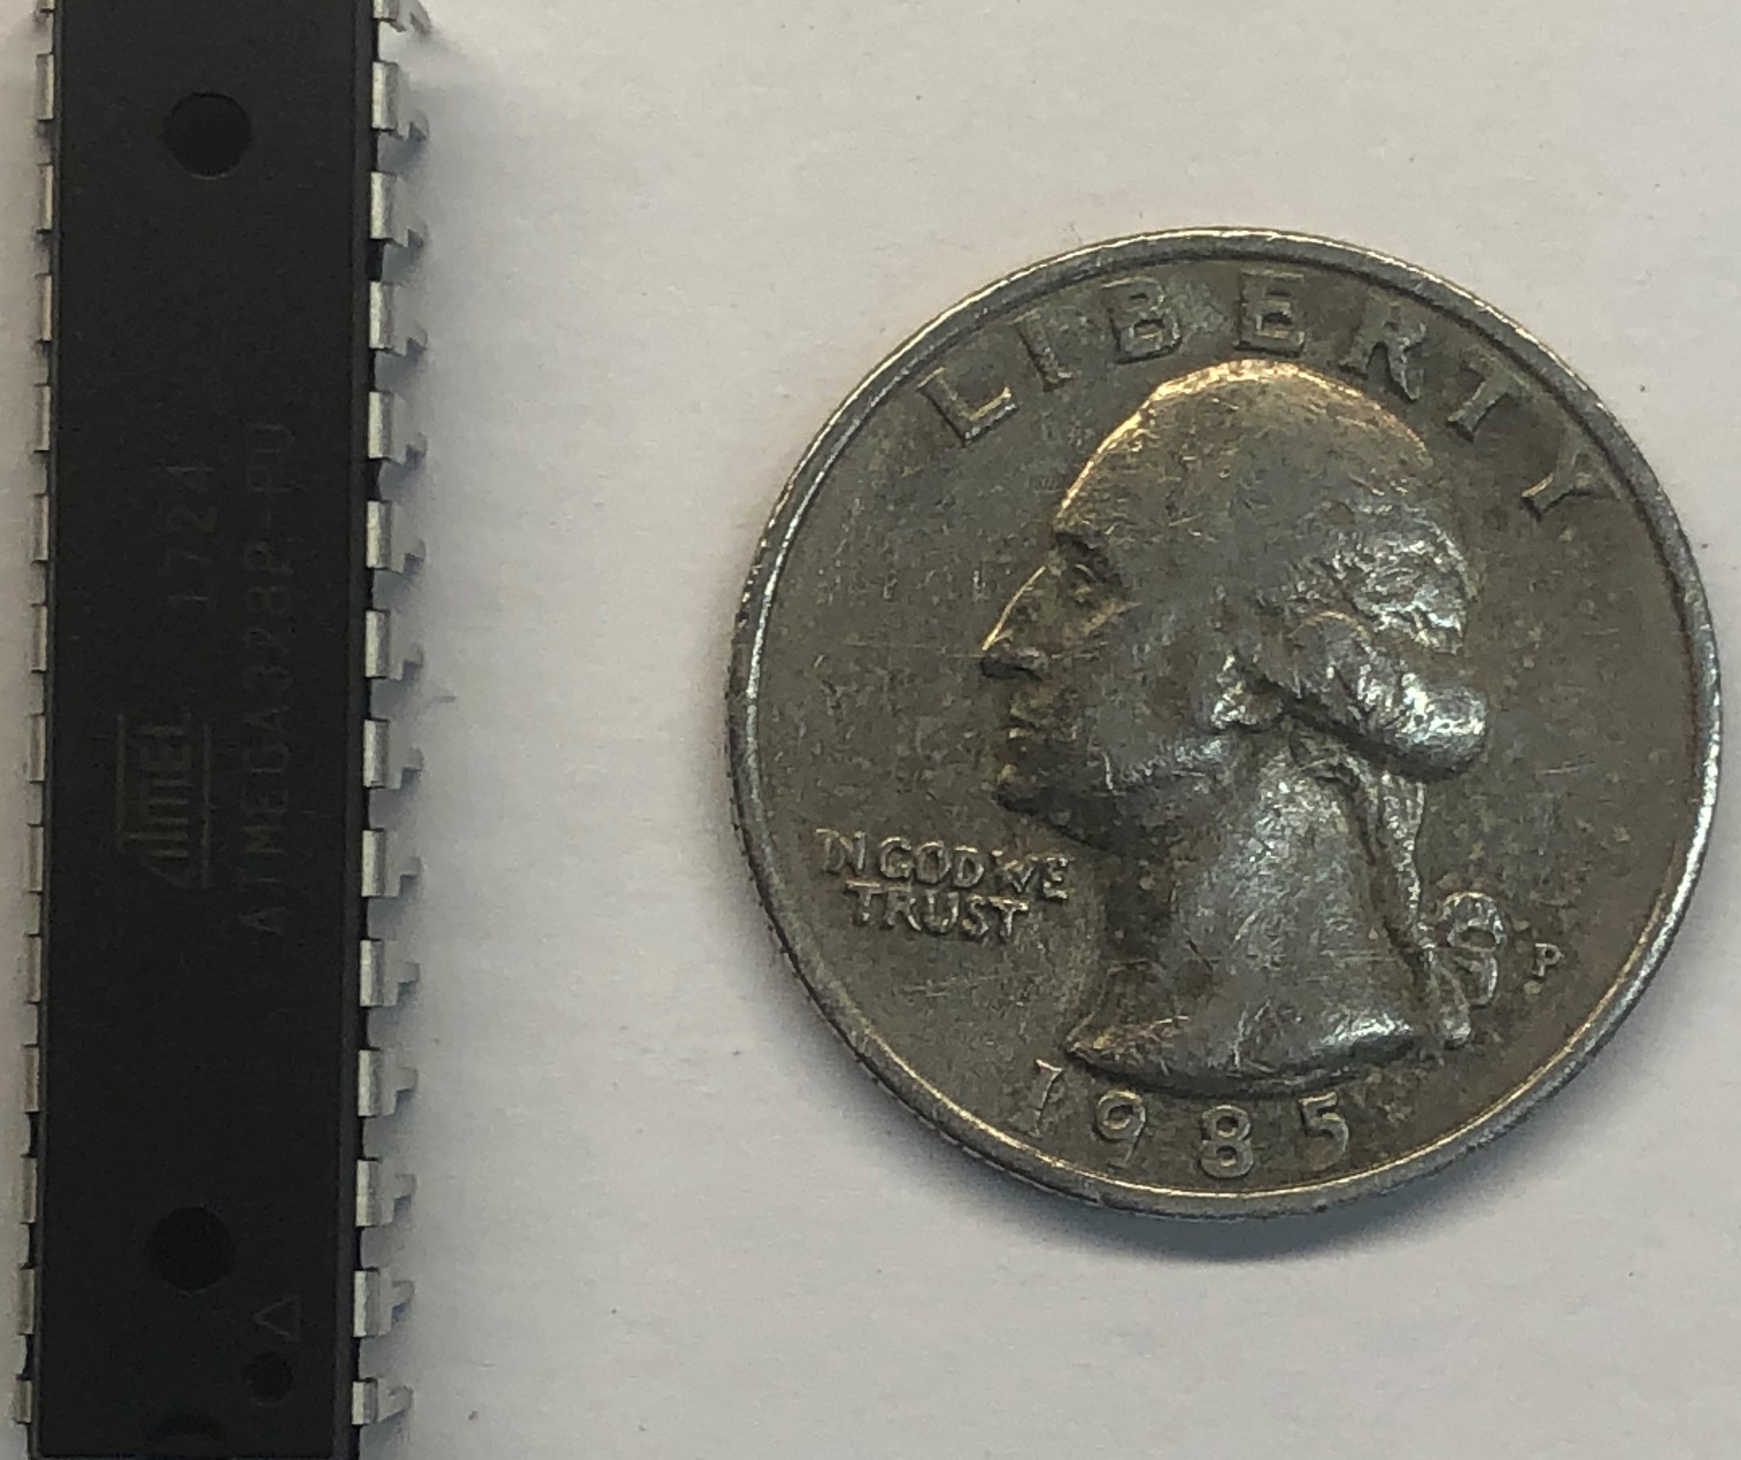
Microcontroller
ATMEGA328P-PU
Provides communication to sensors & other onboard electronics
Provides control for servos & sensors
Manufacturer | Atmel
Pin Count | 28
Speed (MHz) | 20
Power Supply (V) | 1.8 - 5.5
Method of Communication | UART
Price | $2.14

Slide 13
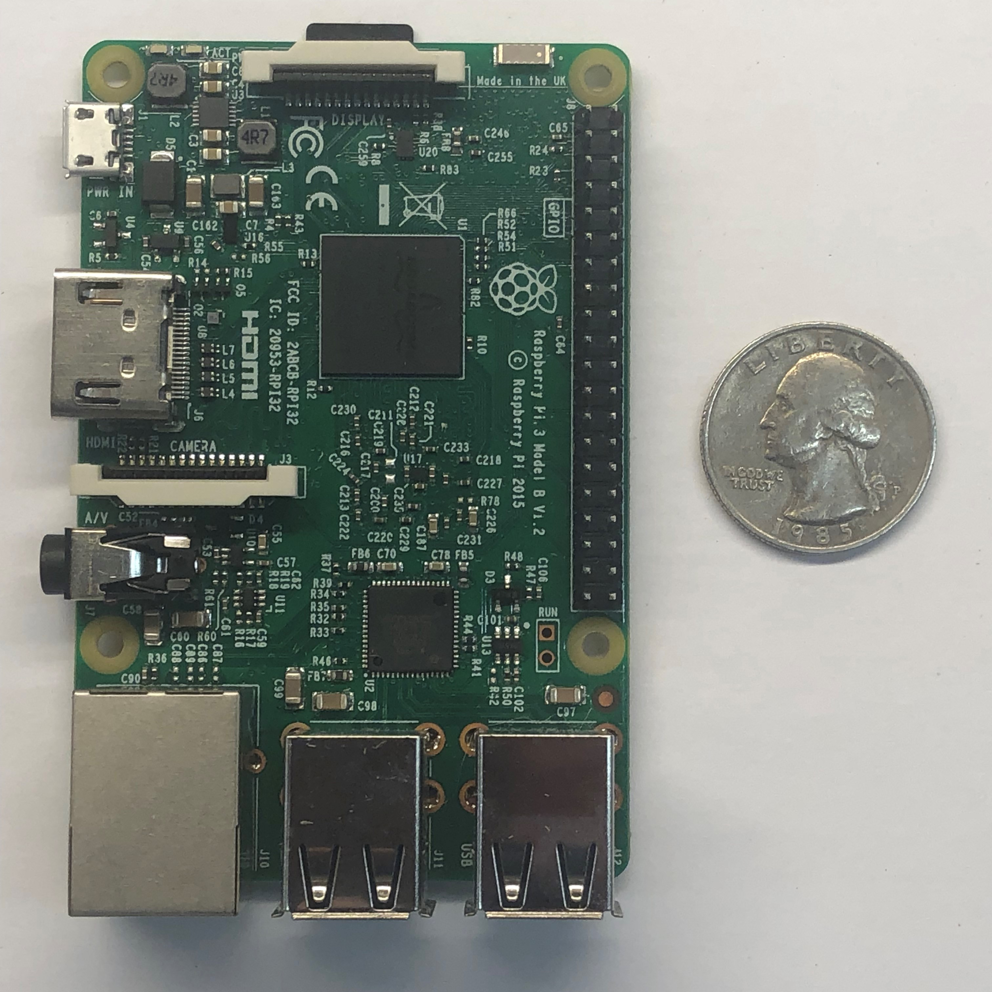
Computer
Raspberry Pi
Analyze & processes received data
Adjusts vehicle’s direction & speed
Manufacturer | Raspberry Pi Foundation
CPU | Quad Core 1.2GHz Broadcom BCM2837 64bit
RAM | 1 GB
GPIO | 40
Memory | Micro SD

Slide 14
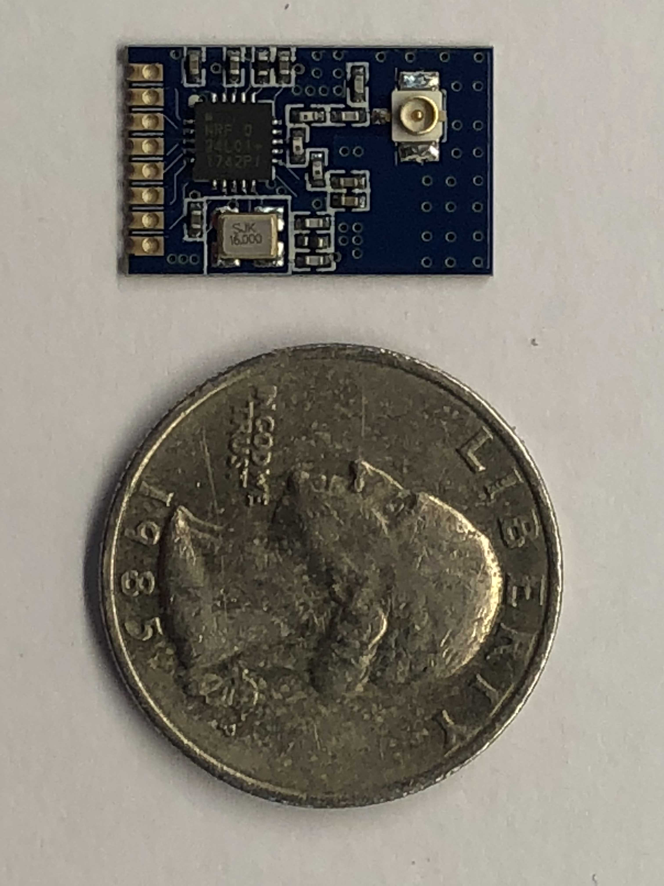
Wireless Communication
E01-ML01IPX
Enables vehicle to communicate with mesh network of sensors
Uses 802.15 Standard
802.15 Standard
Wireless Personal Area Network (WPAN)
Low cost
Low power consumption
Technology | WiFi (802.11) | Bluetooth (802.15)
Range | 100m - 300m | ≤10m
Power Consumption | 80mW | 2mW
Cost | $11.95 | $2.33

Slide 15
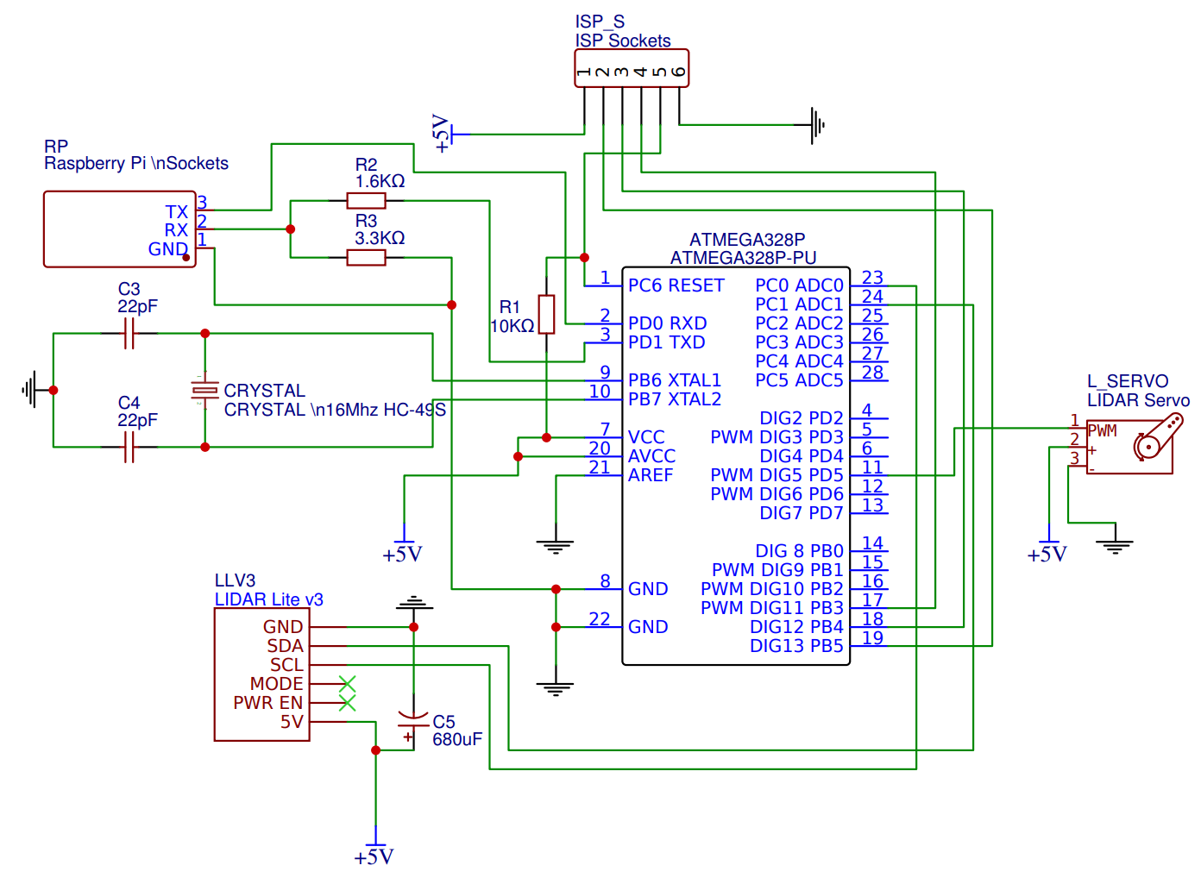
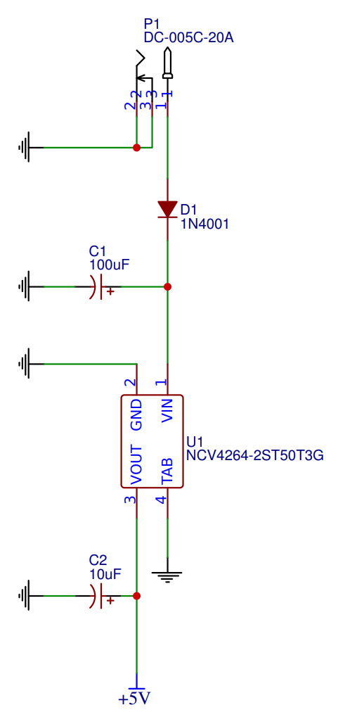
PCB Schematic

Slide 16
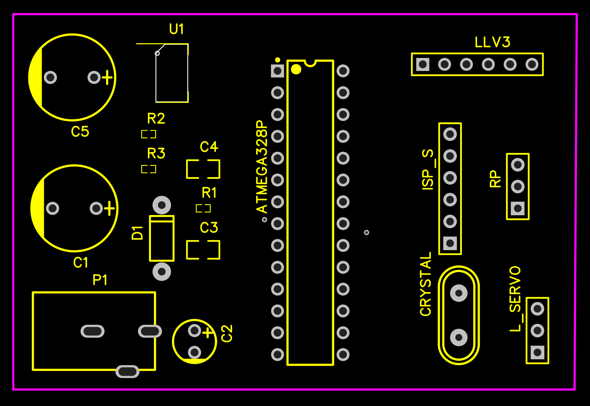
PCB Layout
Indication | Color
Device Outline
Pin Placement
PCB Perimeter

Slide 17
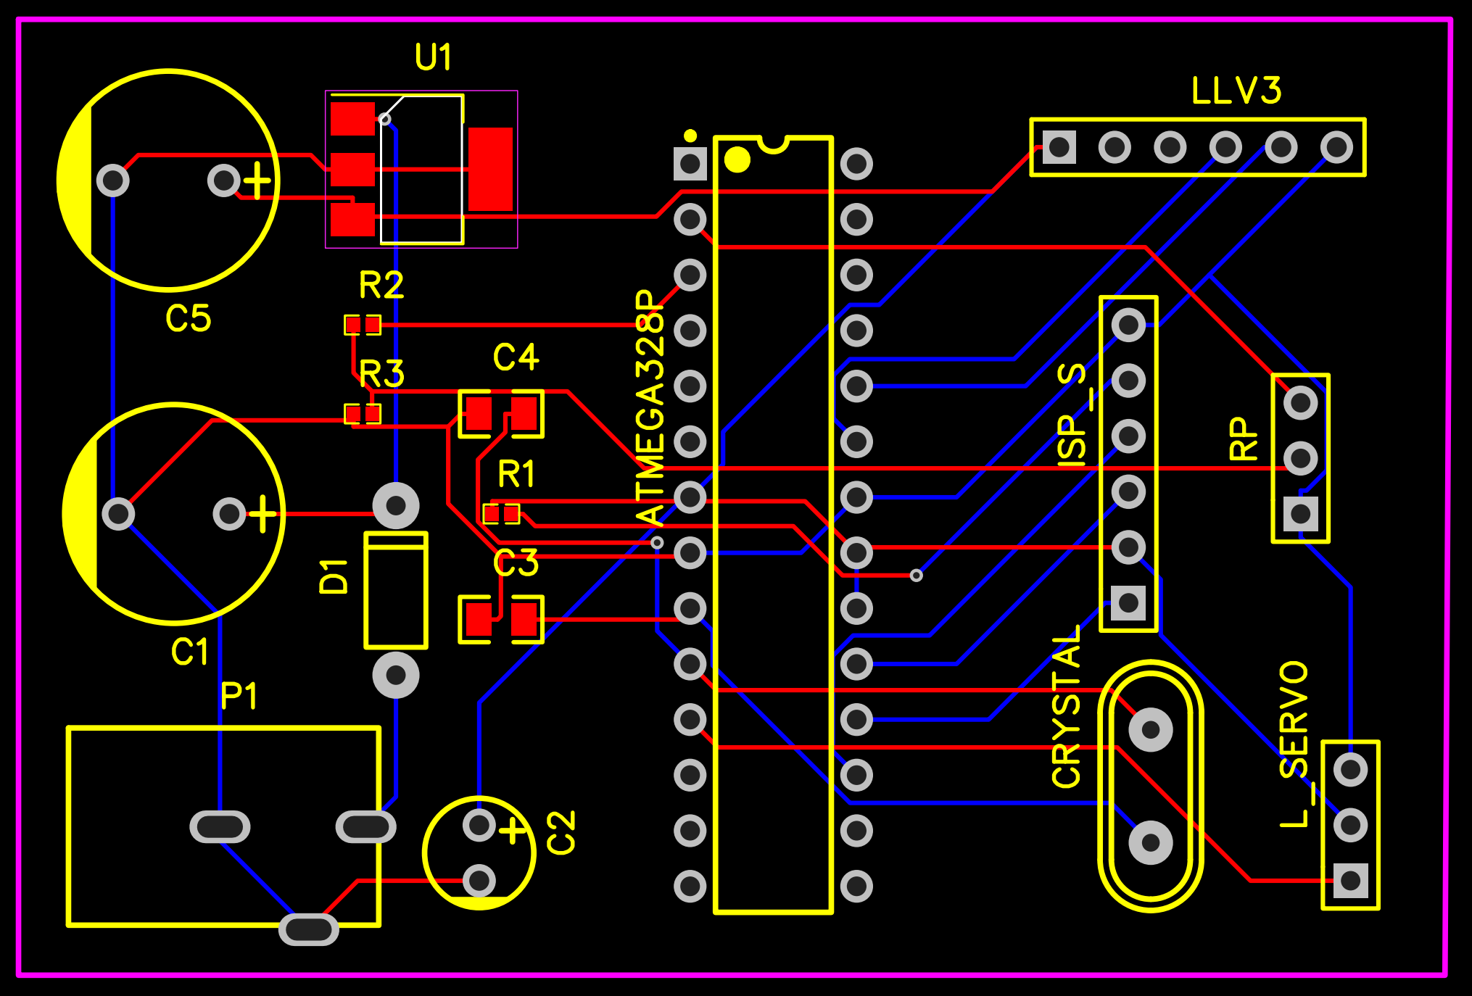
PCB Layout
Indication | Color
Top Layer
Bottom Layer

Slide 18
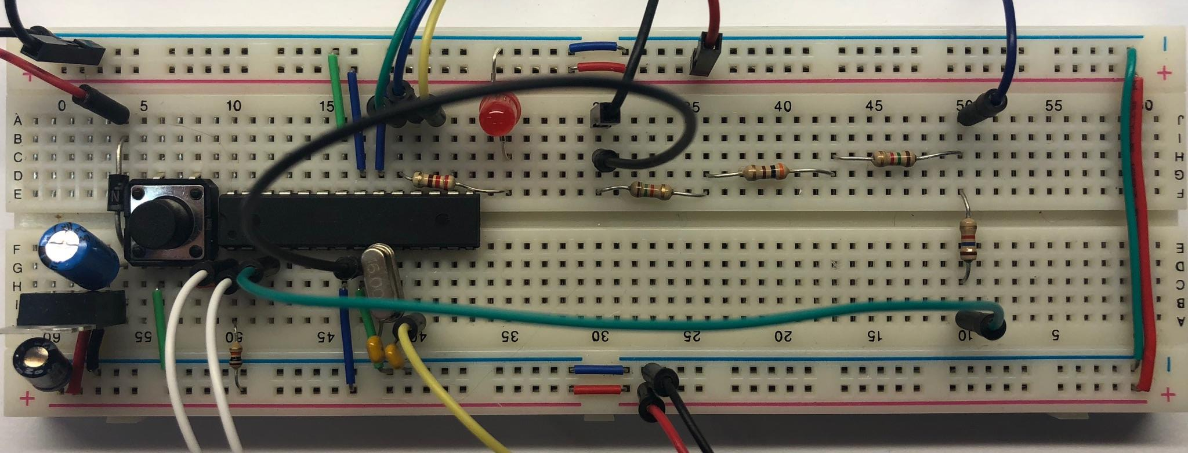
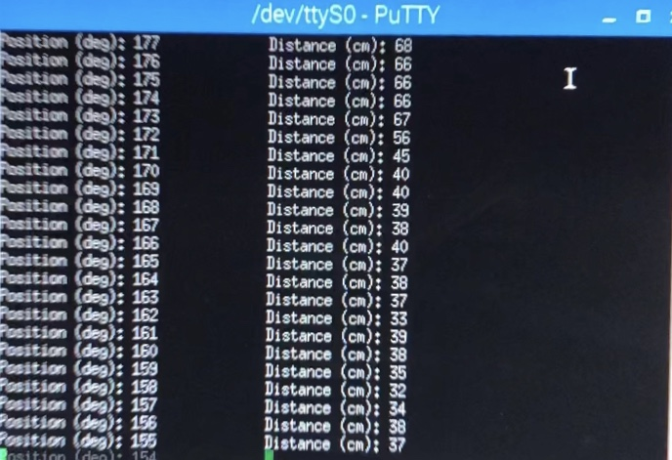
Prototyping
Device | Raspberry Pi | ISP | Servo | Power Jack
Color

Slide 19
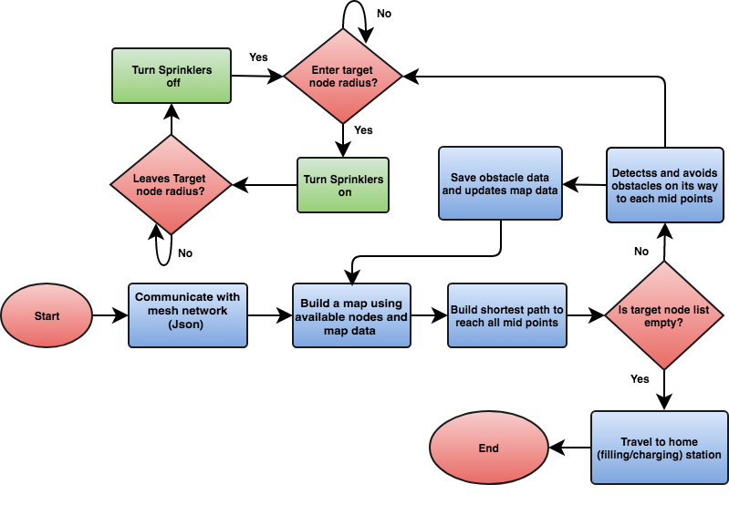
Software Flowchart

Slide 20
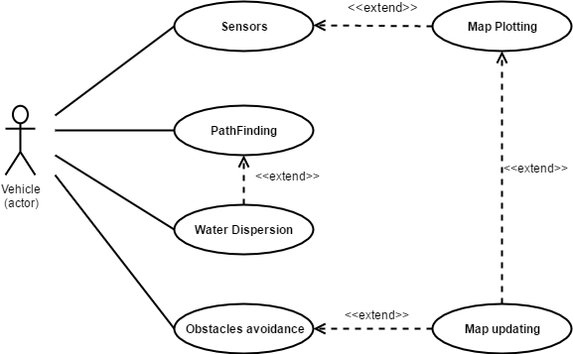
Use Case Diagram

Slide 21
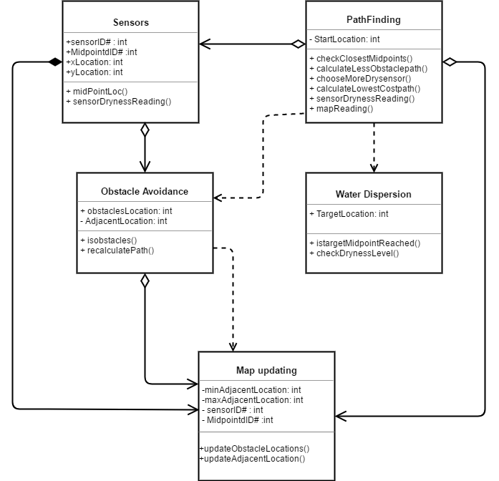
Class Diagram
3 Main classes
Midpoints
Locations
Sensors

Slide 22

Operating System
The Raspberry Pi uses the Raspbian Stretch OS.
Raspbian is a Linux based OS optimized for the architecture of Raspberry Pi.
Raspbian comes with the gcc complier for C++ and most standard libraries included.
It also includes the Geany IDE for the C and C++ languages.
Additional libraries have to be downloaded through the command prompt.

Slide 23

Communication with mesh network
Communication with mesh network through Json
Json (JavaScript Object Notation) is a syntax for storing and exchanging data
Light weight data-interchange format
Json simpler than XML
Language independent
Collection of name and value pair
Using Jsoncpp library

Slide 24
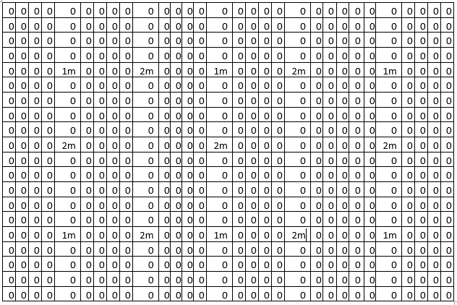
MAP PLOTTING
1m represents sensors
2m represents midpoints
Midpoints are to be used as travel destinations
Midpoints will store the id of the sensors at their edges
They also store the number of sensors at their edges that give dry readings
Maximum dryness of a midpoint is two, minimum is zero.

Slide 25
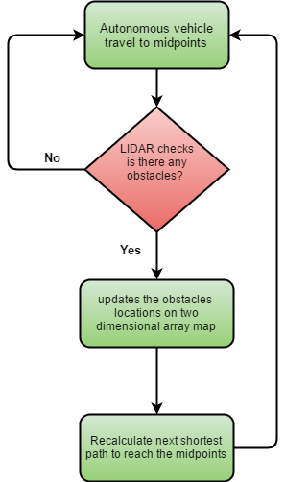
Obstacle Avoidance​
LIDAR​
Learning Phase​
Detects objects on terrain ​
Prevent collisions​
Updates two-dimensional array map​
C++​

Slide 26
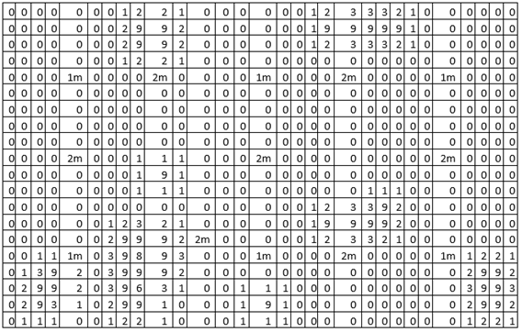
Map Updating​
Two-dimensional array map​
In map number 9 represent obstacle location ​
Maximum number of adjacent obstacle is 8​
Minimum number of adjacent obstacle is 0​
1m represent sensor​
2m represent midpoints

Slide 27
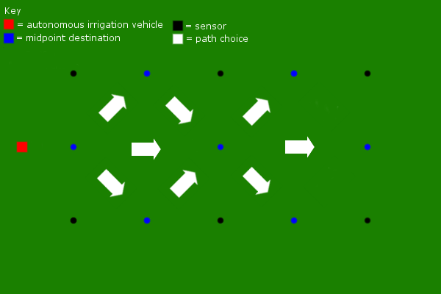
Long Path Finding
Builds a list of midpoints between sensors to travel to.
Orders them based on shortest distance and the readings of sensors at their edge.
Begins by looking to the sensors to its left and right to determine which needs more water.
If both have the same dryness, it moves across the center
If neither are dry, it moves to the neighboring midpoint that is the closest to the next dry midpoint.

Slide 28
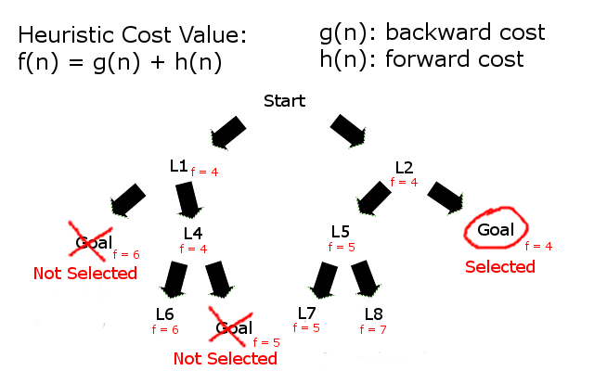
A* Search
Searches all adjacent locations to current location
Calculates heuristic value for each location.
Compares new heuristic to previous value stored in location.
If new heuristic is less than previous one, it adds it to a queue.
Once the goal is reached, it returns a list of locations to reach the goal.

Slide 29
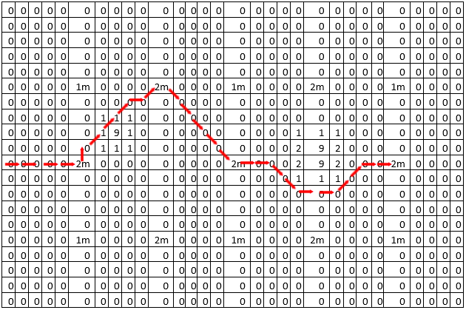
Movement Control of AIV
Takes long path midpoint list
Builds a list of locations to get to each midpoint in the long path using A* Search.
The AIV moves in the direction and distance from current location to the next location on its list.
Keeps track of current location of the AIV while it is moving to each location the list.
Re-calculates its path if new obstacle is detected.
From midpoints: 0 -> 1 -> 3 -> 6

Slide 30
Work Distribution
Name | CPU Interfacing | MCU Interfacing | Communication | Algorithm
Joshua | P | S
Parameswari |  |  | P | S
Roberto | S | P
Stuart |  |  | S | P
Primary | P
Secondary | S

Slide 31
Budget
Component | Cost | Vendor
LIDAR | $149.99 | RobotShop
Ultrasonic Range Finder | $16.00 | RobotoShop
Battery | $10.99 | Amazon
Raspberry Pi | $36.98 | Amazon
Servo | $42.99 | RobotShop
Microcontroller | $4.50 | Amazon
Brackets | $17.90 | RobotShop
RF Module | $4.66 | AliExpress
Total | $284.01
Status | Color
Received
Tested
Financed by Guard Dog Valves

Slide 32
Progress

Slide 33

Questions?

